Slide 1
Coffee Quality Prediction
Advanced Analysis
GROUP 05

Slide 2

Coffee — the best thing to drip into the morning

Slide 3
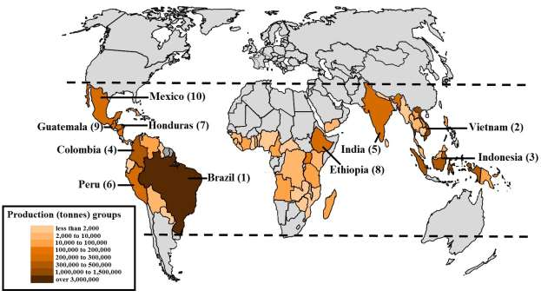
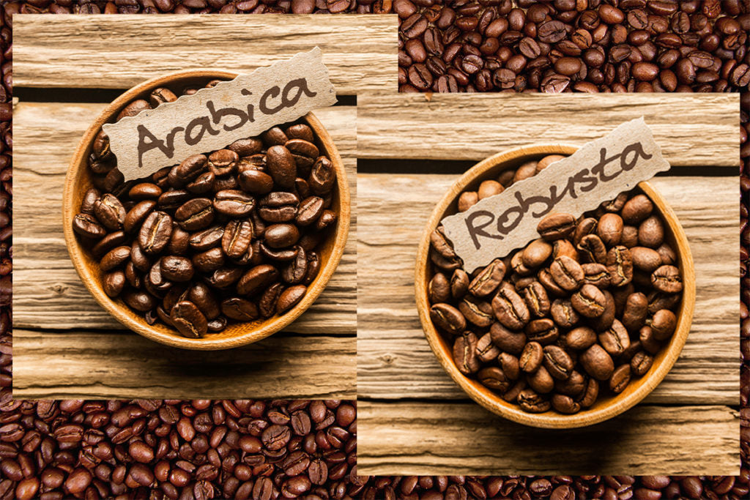
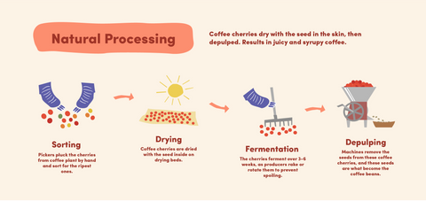
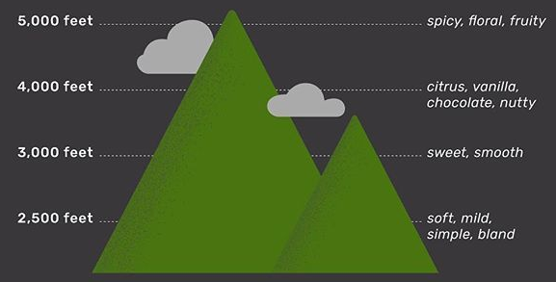
Coffee Quality
Overall sensory experience of brewed coffee
Origin
Variety
Processing Methods
Altitude
Brazil
Ethiopia
Indonesia
Vietnam
Arabica
Robusta
Natural Process
Washed/Wet
Higher Altitudes

Slide 4

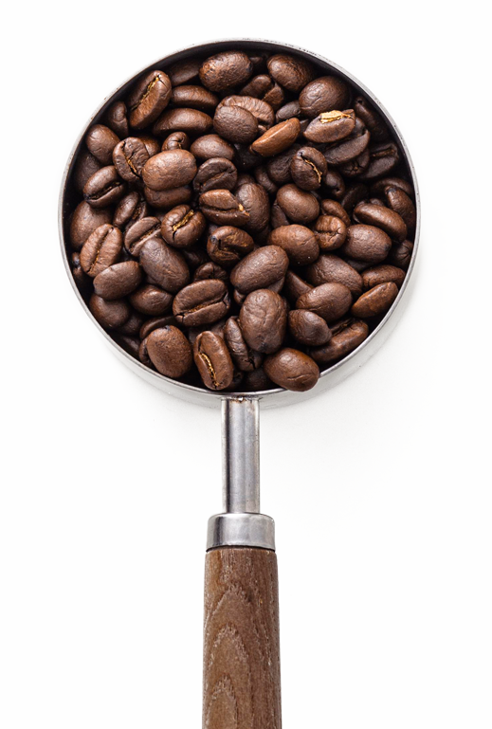

Our Goal
Find factors that are associated with the quality of coffee
Predict the quality of coffee
Help
Customers
To find out better quality coffee easily
Producers
How to produce better quality coffee

Slide 5
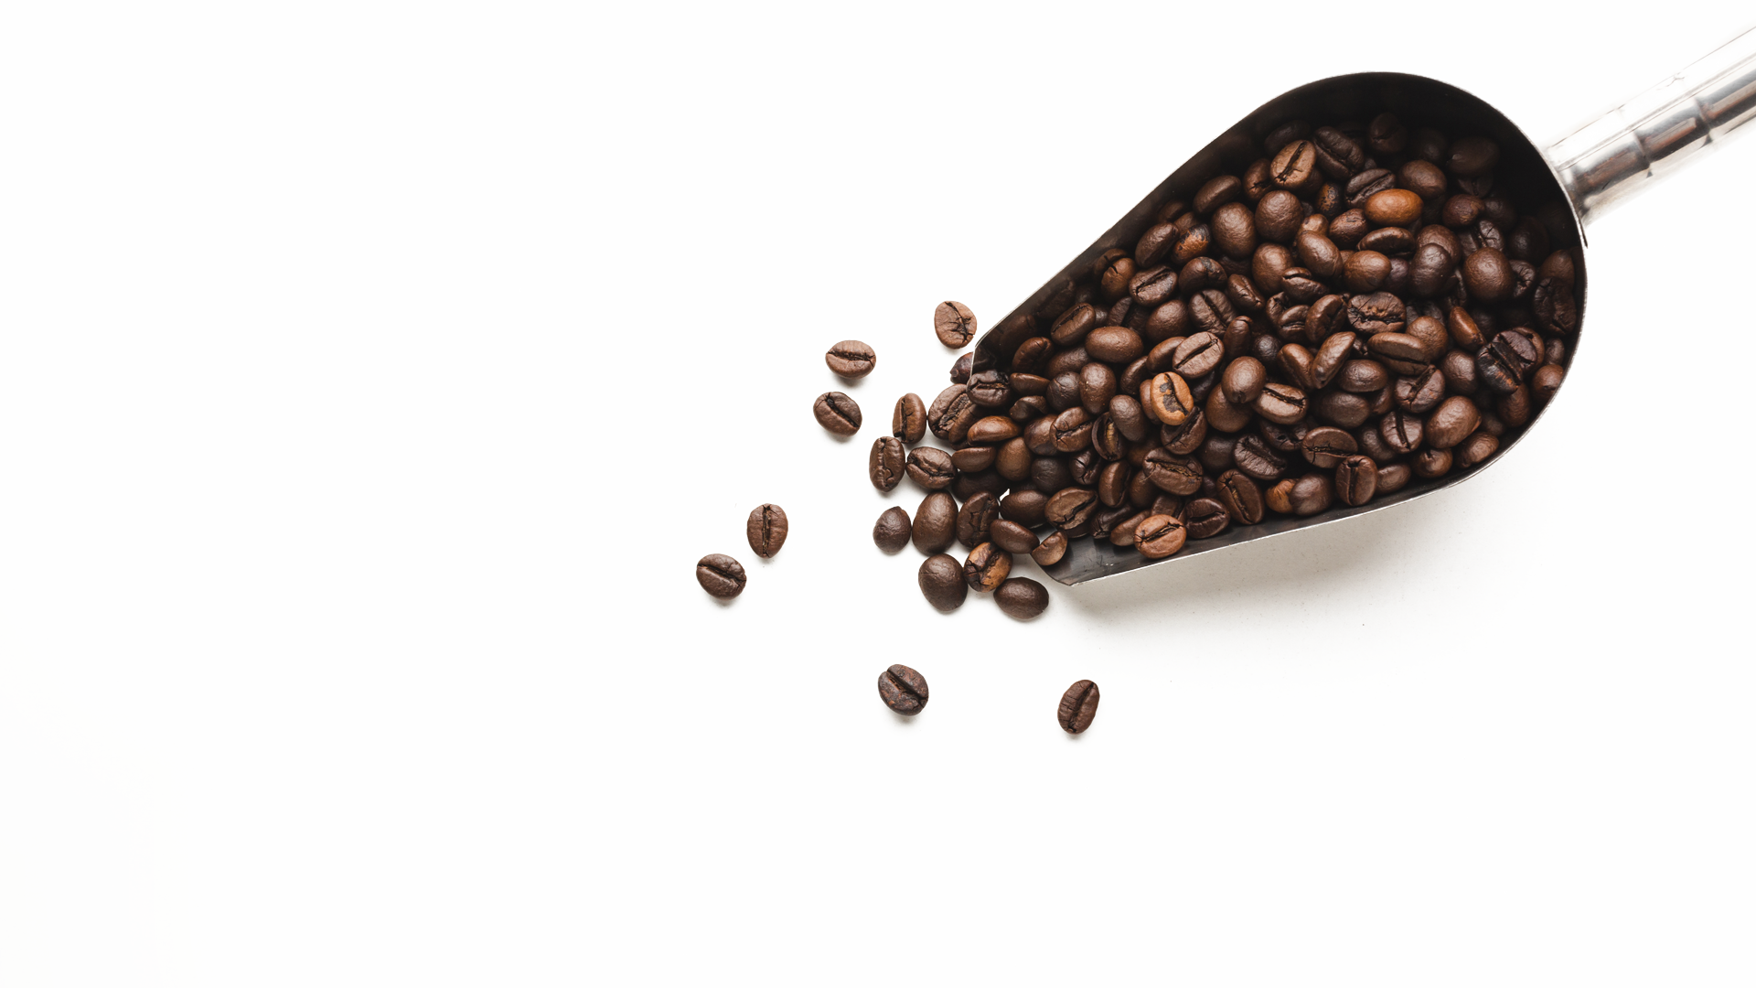

The Data
207
Coffee Quality Observations
41
Variables
New Response – Specialty Coffee Score Grade
TCP>= 90.00
85.00 <= TCP <= 89.99
80.01 <= TCP<= 84.99
TCP< 80.00
Outstanding
Not a Specialty
Excellent
Very Good

Slide 6
Data Pre - Processing
One Hot Encoding
Encode categorical variables of the data set
Splitting
Training – 80%
Testing – 20%

Slide 7
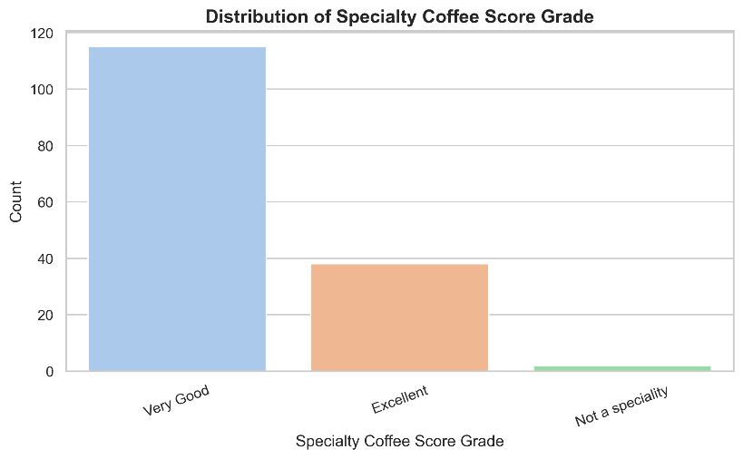

Response Variable
No outstanding coffee.
Majority is very good.

Slide 8
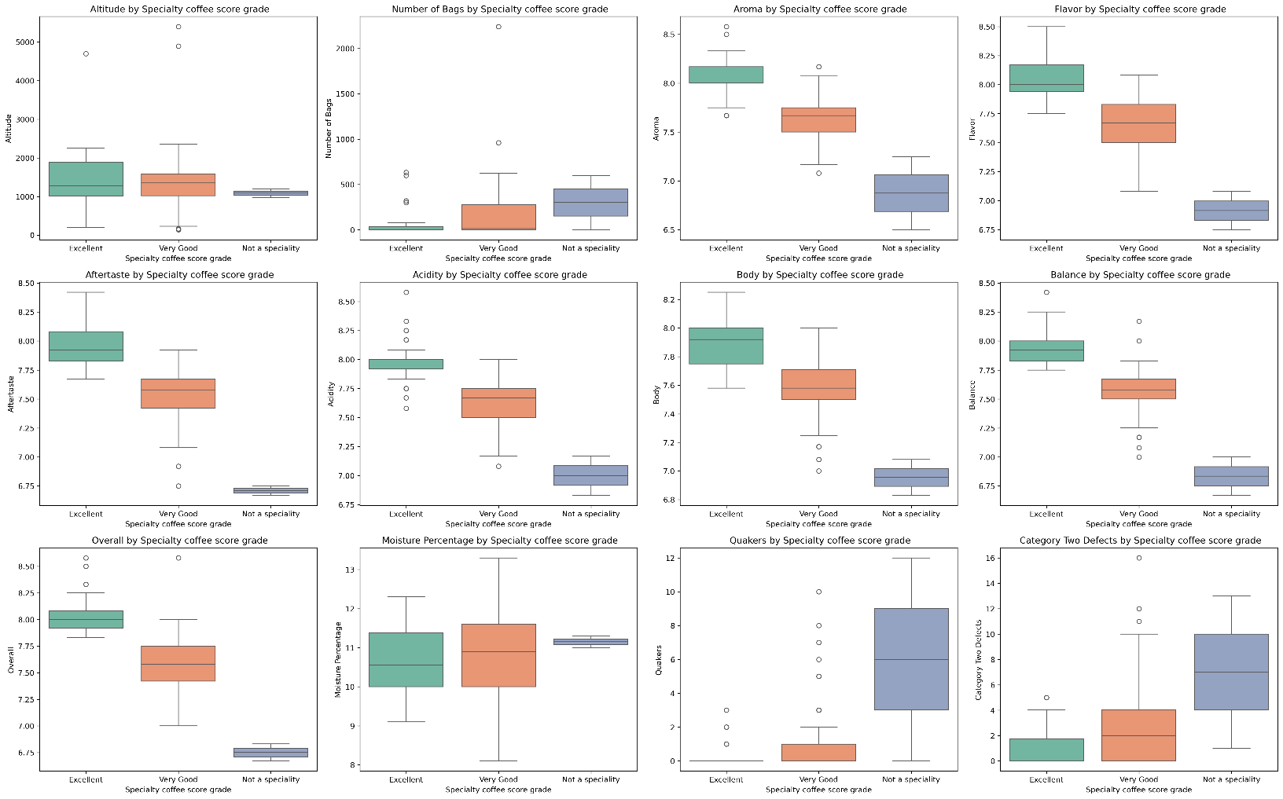
Numerical Variables
Kruskal Wallis Test at 5% significance level
Factors having association
Factors having no significant association
Aroma
AfterTaste
Flavor
Acidity
Body
Category Two Defects
Balance
Overall
Altitude
Number of bags
Moisture Percentage
Quakers

Slide 9
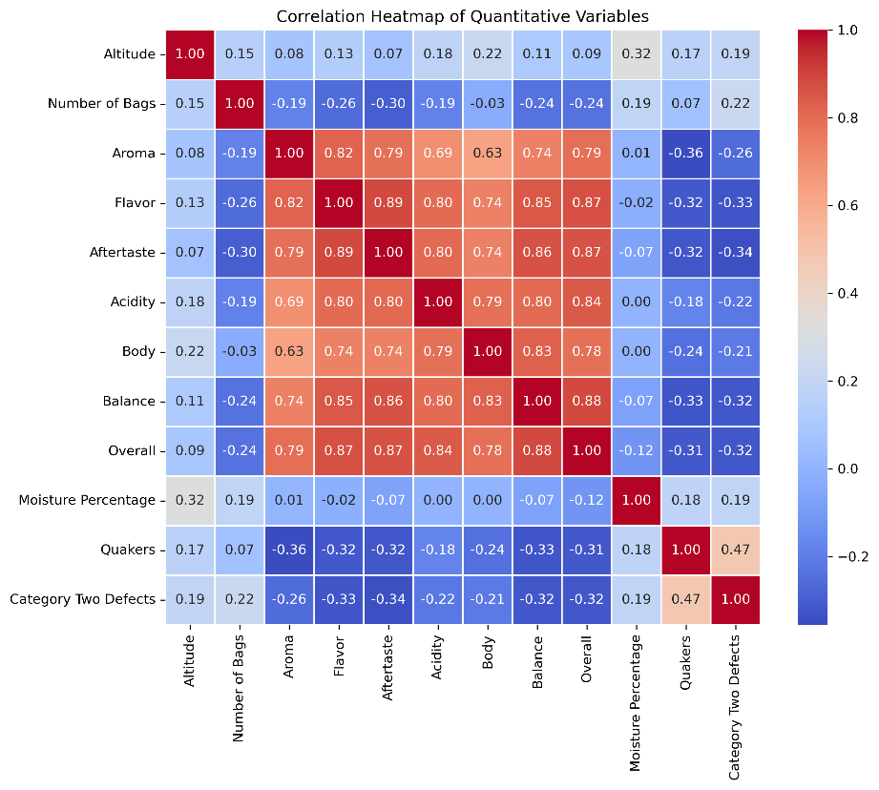

Correlation Among Numerical Variables
Strong Positive Correlation among sensory attributes:
Aroma, Flavor, Aftertaste, Acidity, Body, Balance, and Overall Score
Defects Lower Quality:
Category Two Defects and Quakers show moderate negative correlations with quality scores.
Altitude & Moisture:
Show mild or no correlation with quality.
Multicollinearity Exists

Slide 10
Categorical Factors
Chi-Square Test of Independence at 5% significance level.
Significant Associations
No Significant Association
Country of Origin
Region
In-Country Partner
Harvest Year
Variety
Processing Method
Certification Body
Company
Owner
Color

Slide 11
02
Advanced analysis

Slide 12
Trouble with ‘Not a specialty’

Slide 13



Trouble with ‘Not a specialty’
Not a specialty
Do not have enough observations
2 Observations from this class
When split it ended with either no training data or test data from this class
SMOTE
Removing the minority class

Slide 14
Machine learning models for classification
Random forest
XGBoost
SVM
Uses many decision trees to make better predictions
Built on gradient boosting architecture and is popular due to its great accuracy and scalability
tries to find the best boundary known as hyperplane that separates different classes in the data

Slide 15
Another Problem – small sample
Training set
Only 155 observations with minor class imbalance
Bootstrapping
Solution
30 bootstrap samples with 155 observations

Slide 16
Machine learning models for classification
Random forest- training set
Accuracy: 1.00
 | Precision | Recall | F1-score
Excellent | 1.00 | 1.00 | 1.00
Very good | 1.00 | 1.00 | 1.00
Random forest- test set
Accuracy:0.9487
 | Precision | Recall | F1-score
Excellent | 0.89 | 0.89 | 0.89
Very good | 0.97 | 0.97 | 0.97

Slide 17
Machine learning models for classification
XGBoost - training set
Accuracy: 1.00
 | Precision | Recall | F1-score
Excellent | 1.00 | 1.00 | 1.00
Very good | 1.00 | 1.00 | 1.00
XGBoost - test set
Accuracy: 0.9744
 | Precision | Recall | F1-score
Excellent | 0.90 | 1.00 | 0.95
Very good | 1.00 | 0.97 | 0.98

Slide 18
Machine learning models for classification
SVM- training set
Accuracy: 0.5132
 | Precision | Recall | F1-score
Excellent | 0.28 | 0.67 | 0.39
Very good | 0.82 | 0.47 | 0.59
SVM - test set
Accuracy: 0.5641
 | Precision | Recall | F1-score
Excellent | 0.30 | 0.67 | 0.41
Very good | 0.84 | 0.53 | 0.65

Slide 19
Test set Accuracy summary
Test set accuracies
Random forest | 0.95
XGBoost | 0.97
SVM | 0.56
Best model

Slide 20
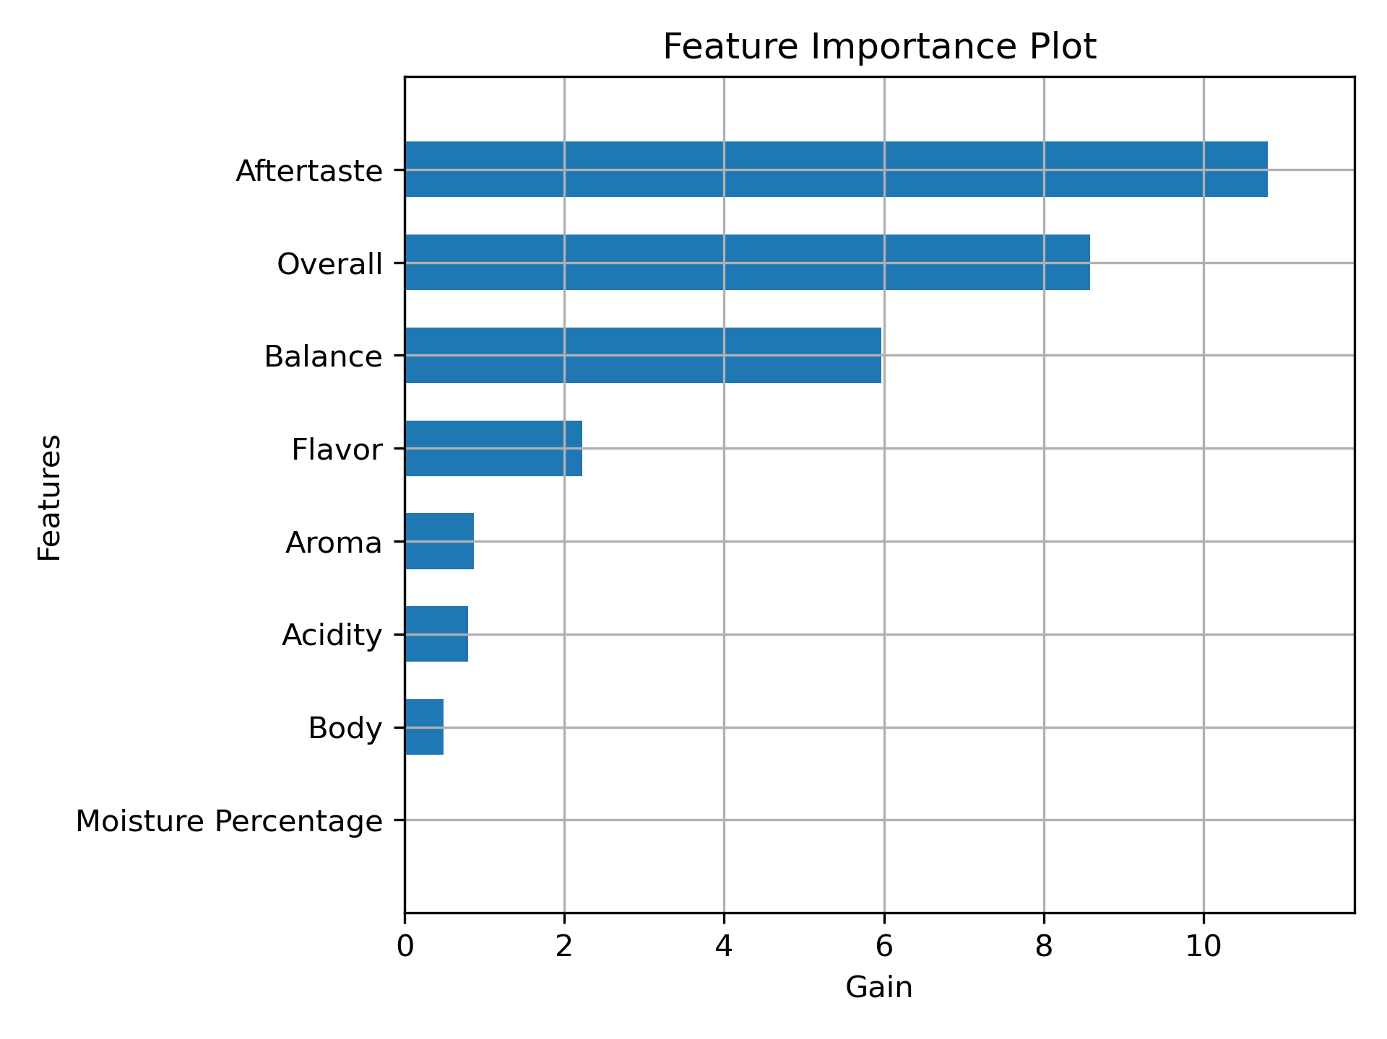
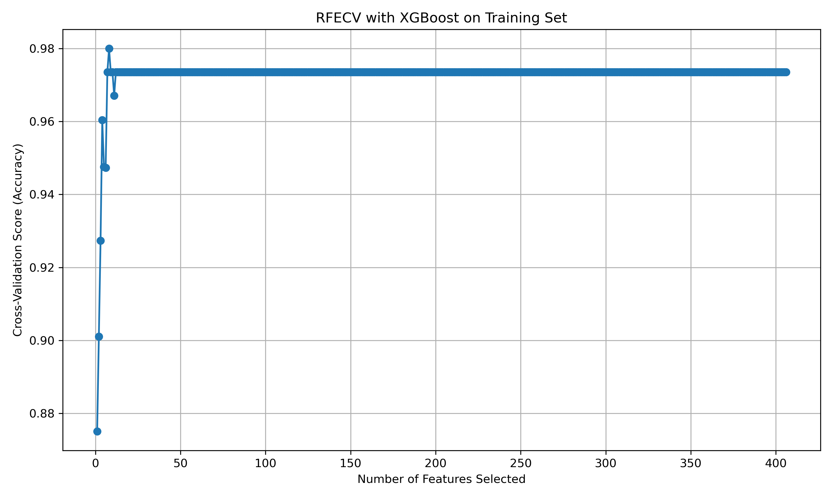
Feature Selection
RFECV- Recursive Feature Elimination with CV
Model: XGBoost Classifier
CV Strategy: Stratified K-fold (5-fold)
Optimal no.of features: 8
Selected Features:
Aftertaste, Overall, Balance, Flavor, Aroma, Acidity, Body, Moisture Percentage

Slide 21
Hyperparameter Tuning
Bootstrap Aggregation + Grid Search with Stratified CV(3-fold)
XGBoost - training set (After tuning)
Accuracy: 1.00
 | Precision | Recall | F1-score
Excellent | 1.00 | 1.00 | 1.00
Very good | 1.00 | 1.00 | 1.00
XGBoost - test set (After tuning)
Accuracy: 0.97
 | Precision | Recall | F1-score
Excellent | 0.90 | 1.00 | 0.95
Very good | 1.00 | 0.97 | 0.98

Slide 22
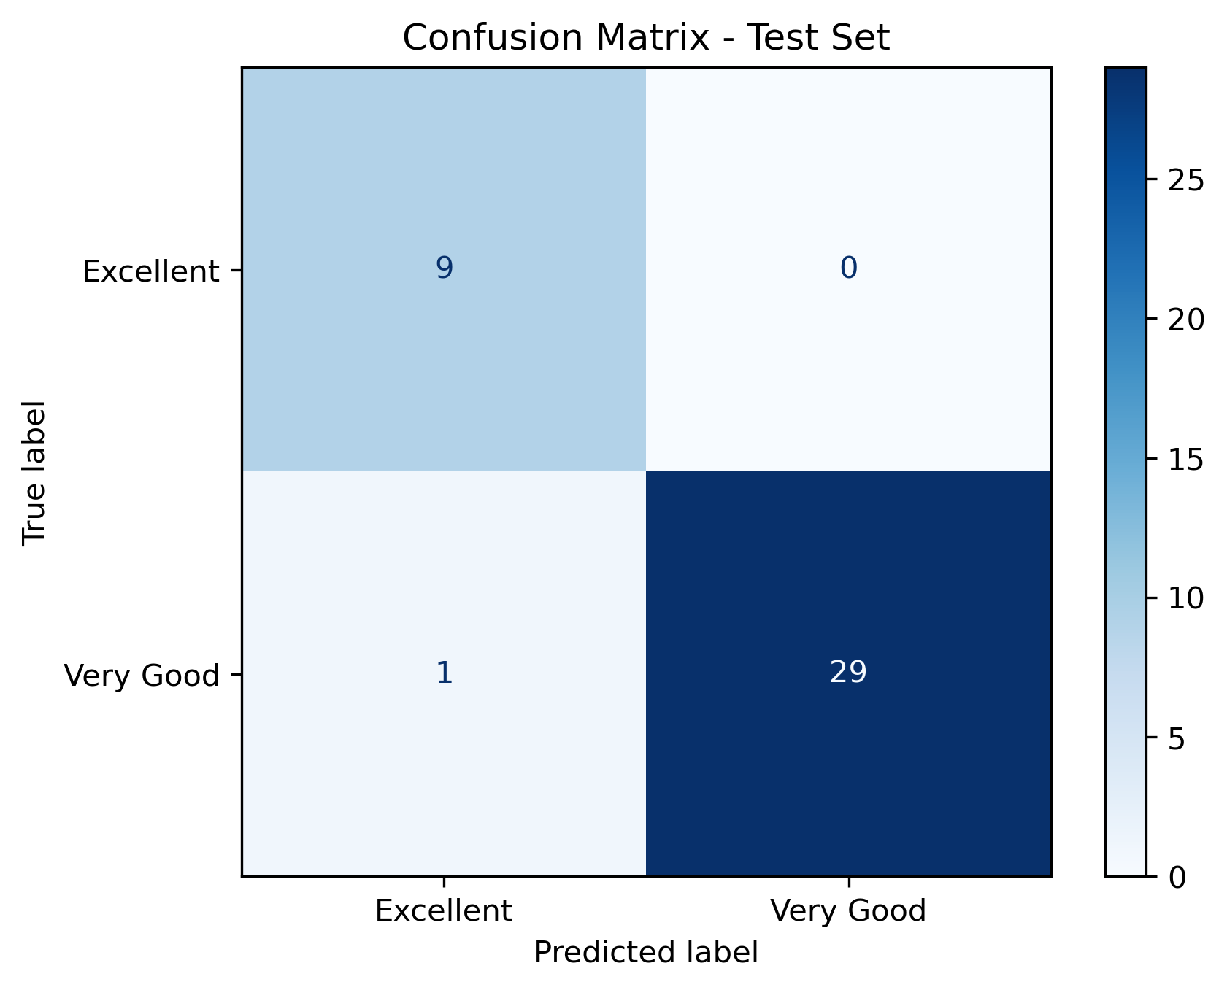
Confusion Matrix
Visual representation of correct vs incorrect predictions.
Only 1 misclassification.

Slide 23
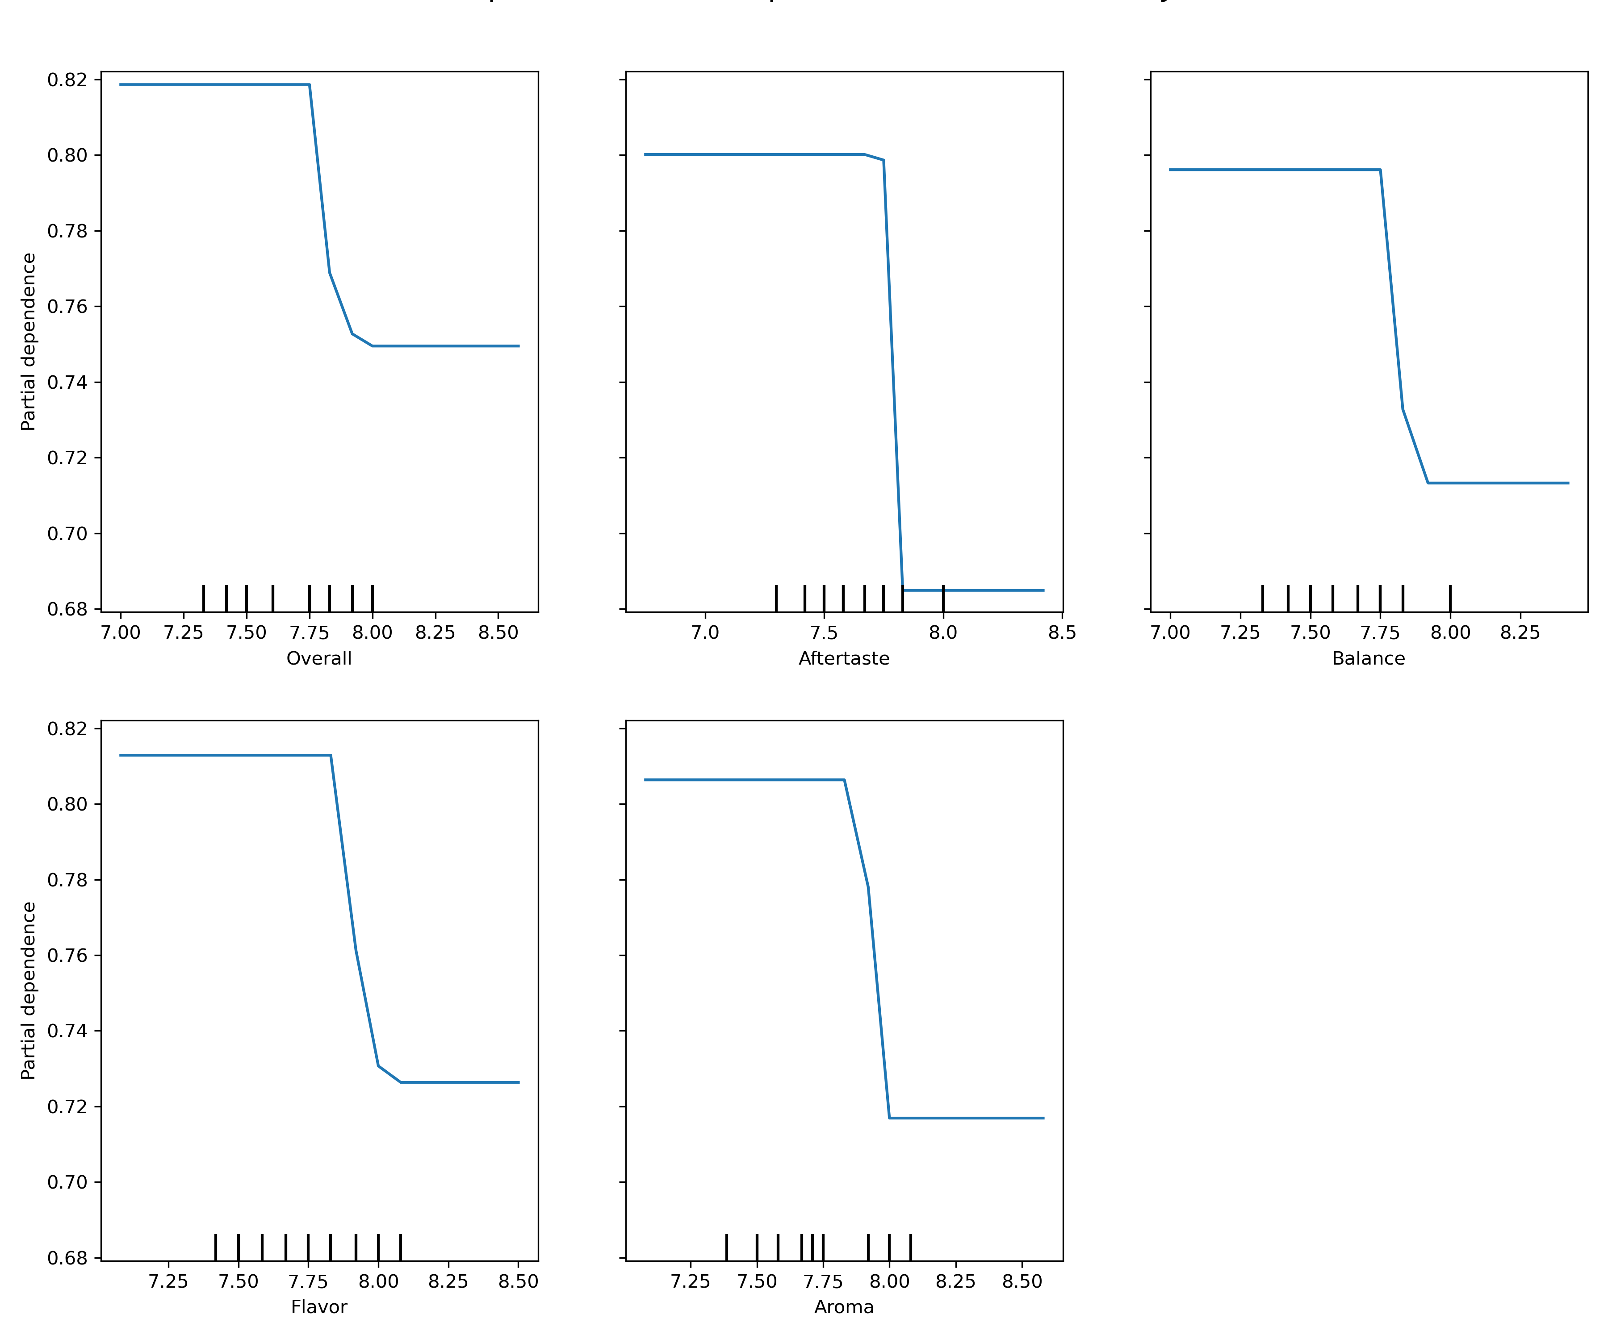
Partial dependency plots
When overall scores <= 7.8, the probability of being predicted as “very good” remains high
Similarly, all other 4 plots also shows the same pattern

Slide 24
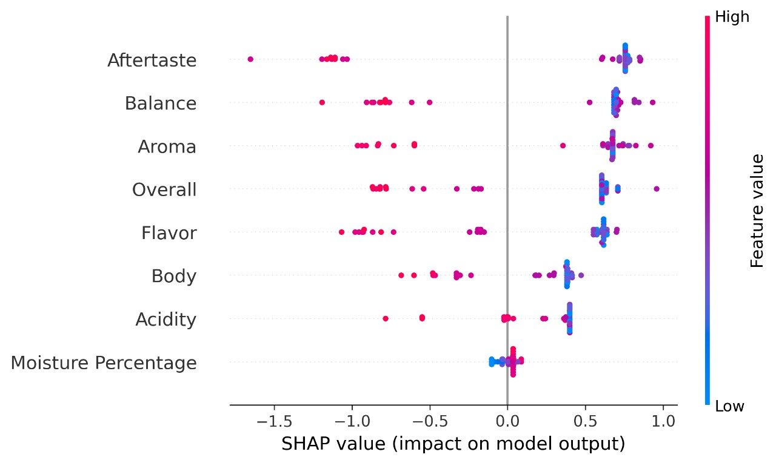
Shap plot
Aftertaste is the most influential variable
High values for aftertaste have a strong positive impact, significantly increasing the models output score

Slide 25

How would have our data product look like
Frontend
React.js
Vite
Tailwind css
ShadCn UI
Backend
Flask
Node.js

Slide 26
Standard vs our dataset
Aroma, flavor , acidity, body, aftertaste are the 5 most important attributes of coffee quality- Coffee bean roasting house
Aftertaste, Balance, Aroma, flavor, Body are the 5 most important attributes of coffee quality – Our analysis

Slide 27
Message to the producers
This project not only builds a high-performing predictive model for coffee grading but also provides actionable insights for producers to focus on improving specific sensory attributes (e.g., aroma, flavor balance) to achieve better specialty coffee scores.

Slide 28
References
https://www.geeksforgeeks.org/machine-learning/stratified-k-fold-cross-validation/
https://github.com/xbeat/Machine-Learning/blob/main/Stratified%20K-Fold%20Cross-Validation%20in%20Python.md
https://scikit-learn.org/stable/modules/partial_dependence.html
https://www.investopedia.com/terms/stratified_random_sampling.asp
https://www.geeksforgeeks.org/machine-learning/random-forest-algorithm-in-machine-learning/
https://www.educative.io/answers/classification-using-xgboost-in-python
https://www.geeksforgeeks.org/machine-learning/support-vector-machine-algorithm/
https://carpentries-incubator.github.io/machine-learning-novice-python/07-bootstrapping/
https://www.geeksforgeeks.org/machine-learning/recursive-feature-elimination-with cross-validation-in-scikit-learn/

Slide 29

GROUP 05
Kavindi Chamathka - s16367
Nethmi Sansala - s16252
Kavindu Weerasekara - s16076

